Slide 1
Applied Data Science Project 4
Yuhan Guo
Bohong Zheng
Xiang Li
Jiahao Wang

Slide 2
About the Data
Data from: Brazilian E-Commerce Public Dataset by Olist
Data Structure:
High complexity: involves 7 related tables (orders, reviews, products, locations, etc.).
Processing scale: Over 90,000 orders.
Cleaning Tasks:
Merge tables: Merge the 7 tables into a single table based on order number, product number, customer number, and seller number.
Business logic filtering: Remove orders with logical inconsistencies (e.g., “delivery date earlier than order date”) to ensure data integrity.

Slide 3
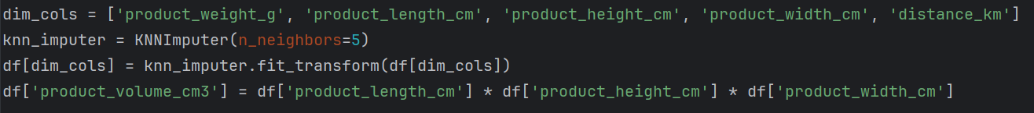
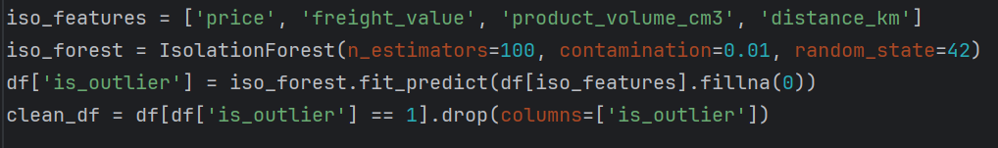
About the Data
K-Nearest Neighbor: Fills in missing dimensions using attributes from similar products, providing greater accuracy than simply filling in the median and maximizing information retention.
Isolation Forest: Automatically identifies high-dimensional anomalous orders, such as “extremely lightweight items with extremely high shipping costs,” to prevent interference from erroneous data.
Standardization: Applies StandardScaler to ensure all features are on the same scale.

Slide 4
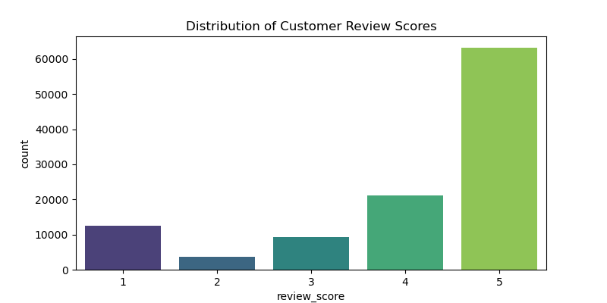
Exploratory Data Analysis
Reveals the skewed distribution of review_score (few 1-2 star ratings, many 5-star ratings).
Delayed shipment?
High shipping costs?
…

Slide 5
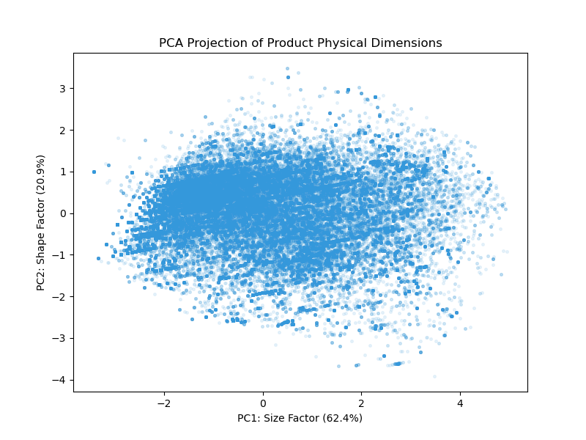
Exploratory Data Analysis
Unsupervised Learning Applications: Principal Component Analysis
PC1 captures “Size”
PC2 captures “Shipping costs”

Slide 6
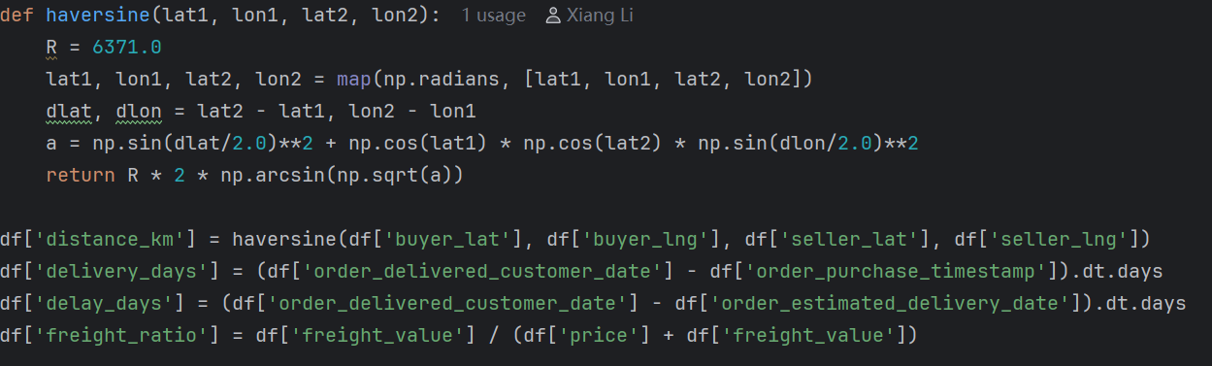
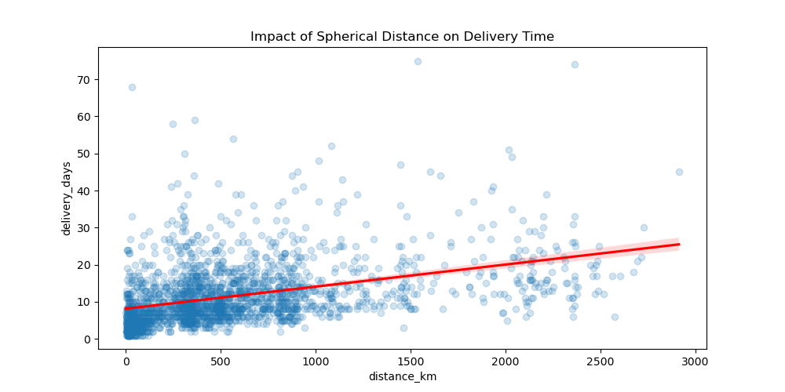
Feature Engineering & Preprocessing
Haversine Distance
How we do that: Utilizes trigonometric functions to process latitude and longitude.
Why we do that: In Brazil, with its vast territory, actual spherical distances better reflect the challenges of logistics than straight-line distances.

Slide 7
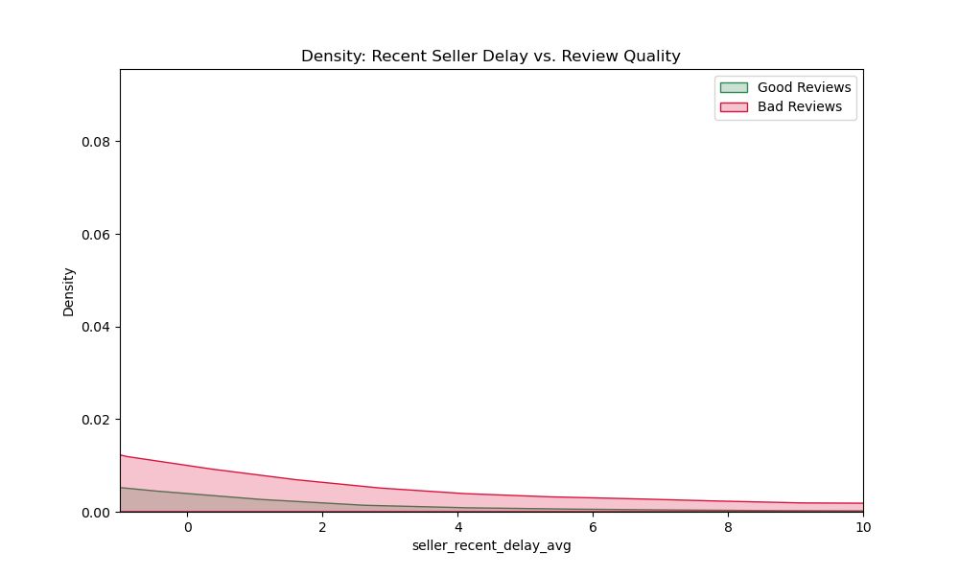
Feature Engineering & Preprocessing
Rolling Window
How we do that: Calculates the seller’s average shipping delay over the past 30 days.
Why we do that: Identifies a seller’s “immediate workload” and “credit decline,” clearly demonstrating the impact of shipping delays on user ratings.

Slide 8
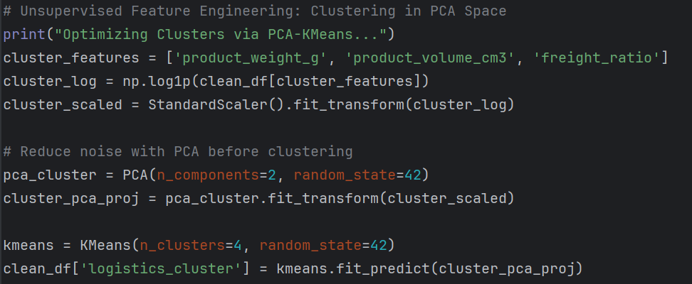
Feature Engineering & Preprocessing
K-Means Clustering in PCA Space
Technical workflow: Logarithmic transformation -> PCA for dimensionality reduction and noise removal -> K-means clustering

Slide 9
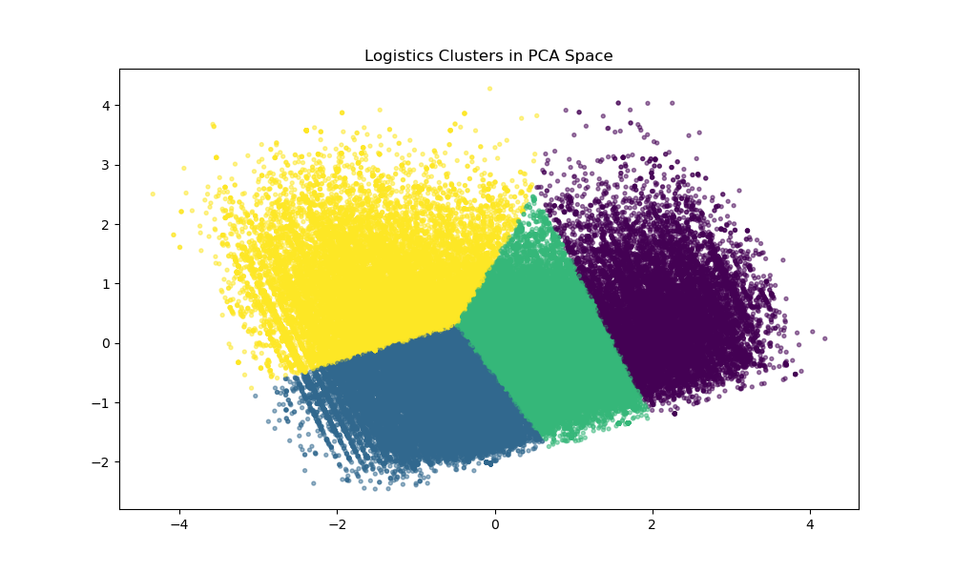
Feature Engineering & Preprocessing
Classify all shipments into four categories:
Low-weight,low-volume, low-shipping-cost shipments
High-weight, high-volume, high-shipping-cost shipments
Low-weight, high-volume, medium-shipping-cost shipments
Low-weight, low-volume, high-shipping-cost shipments

Slide 10
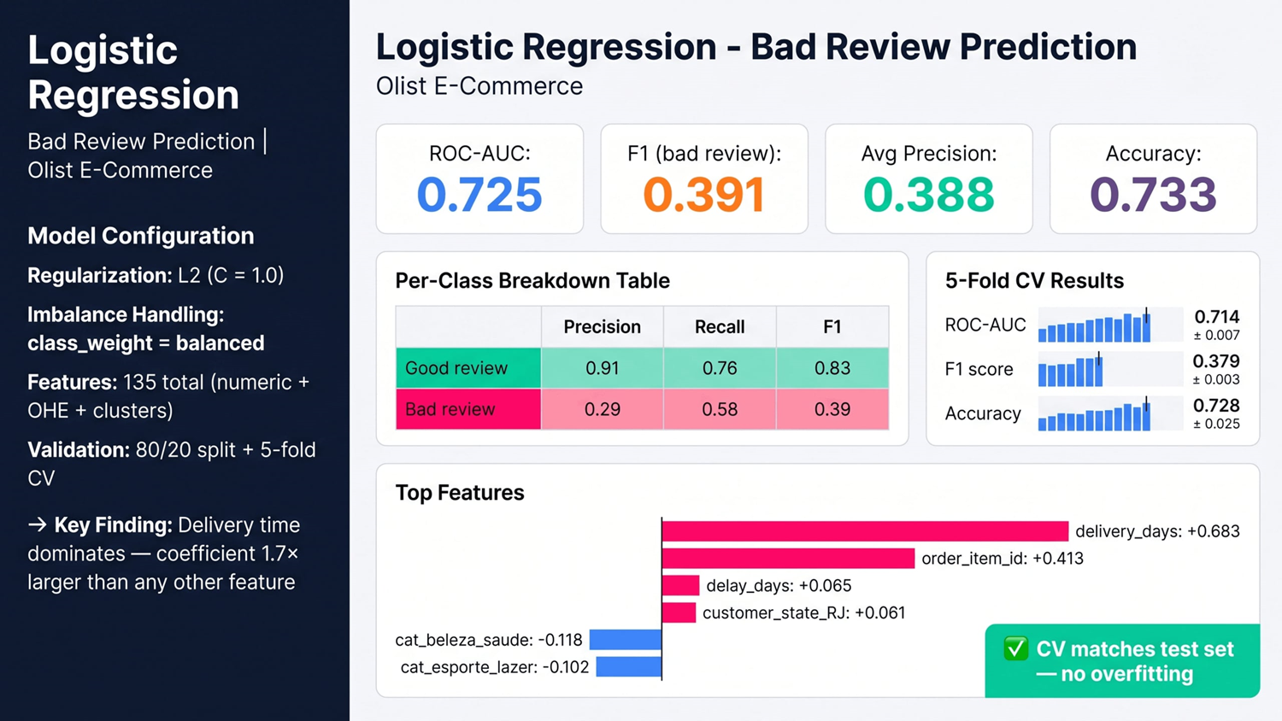
Logistic Regression

Slide 11
Gradient Boosted Trees Model
• Ensemble method based on sequential decision trees
• Each tree corrects errors from previous trees
• Captures nonlinear relationships and feature interactions
Why we choose this model:
• Strong performance on tabular data
• Handles complex patterns better than linear models
Notes:
We chose Gradient Boosted Trees because it is known to perform very well on structured tabular data.
Unlike logistic regression, it can capture nonlinear relationships and interactions between features.
This makes it a strong candidate for our prediction task.

Slide 12
Model Pipeline
1. Data preprocessing
• Missing value imputation
• One-hot encoding for categorical variables
2. Train-test split
• 80/20 split
• Stratified sampling
Notes:
We used a preprocessing pipeline to handle missing values and encode categorical variables.
We applied an 80-20 train-test split with stratification to ensure consistent class distribution.

Slide 13
Model Pipeline
3. Model training
• GradientBoostingClassifier
4. Hyperparameter tuning
• Adjust learning rate and tree depth
Notes:
Then we trained the Gradient Boosted Trees model and performed simple hyperparameter tuning.

Slide 14
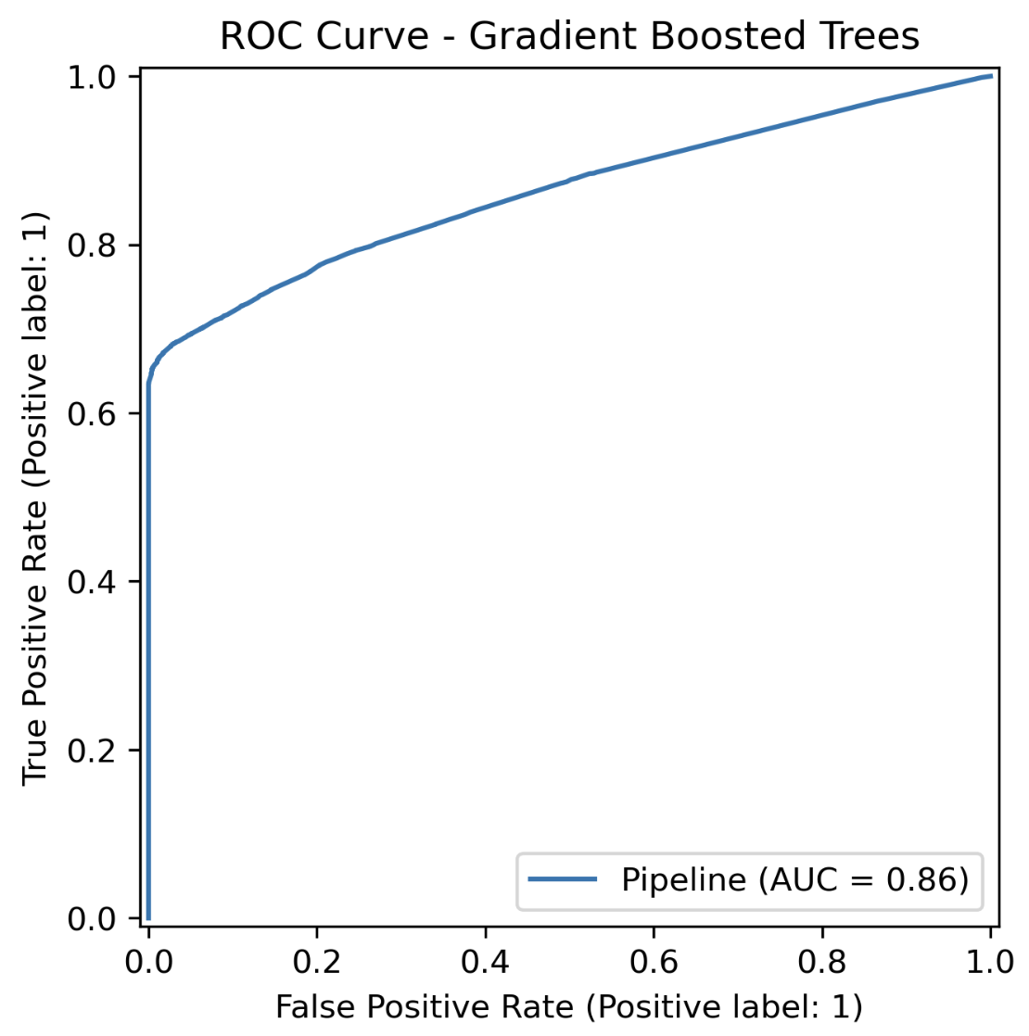
Model Performance
• Strong performance across multiple metrics
• High F1 score and ROC AUC
• Balanced precision and recall
Key Insights
• Behavioral and temporal features are important
• Feature engineering significantly improves performance
Notes:
We evaluated the model using accuracy, precision, recall, F1 score, and ROC AUC.
The model shows strong performance across all metrics, especially a good balance between precision and recall.
Feature importance analysis shows that engineered features play an important role.
Overall, this model performs well and is a strong candidate for final selection.

Slide 15
Predicting Customer Review Score from Order Data
The Question
Feature groups used by the DNN
Given everything known at dispatch time — logistics, product, payment — can we predict the star rating an order will receive?
Group | Examples
Logistics | delay_days, delivery_days, distance_km, freight_ratio, seller_recent_delay_avg
Product | volume_cm³, weight, category (~70 types), photos
Payment | type, installments, value
Geography | seller_state, customer_state (one-hot → 145 total features)
Dataset snapshot
108,911 Brazilian e-commerce orders (Olist)
80 / 20 stratified train / test split
Target: review_score (1–5 ★)
57.5% of orders are 5★ — severe class imbalance shapes the task
Slide 1 / 4

Slide 16
Feed-Forward MLP
Architecture + Training Summary
• 145 input features — logistics, product, payment, geography (one-hot encoded categoricals + pre-engineered numerics)
• 4 hidden layers, width 90 — each block: Linear → BatchNorm → ReLU → Dropout (p = 0.32)
• Output: single scalar, no activation — direct regression on review score (1–5) 38,521 trainable parameters total
• Trained with AdamW + cosine learning-rate decay Early stopping: patience 10 epochs, best weights restored
• Hyperparameter search: Optuna Bayesian optimisation 20 trials × 3-fold CV — objective: mean fold RMSE Best trial: lr = 9.3 × 10⁻³, dropout = 0.32, 4 layers × width 90
• Test set (21,783 orders): RMSE = 1.22 | MAE = 0.95 | R² = 0.18 Predictions monotonically ordered across all 5 star buckets (mean prediction 3.42 for 1★ → 4.21 for 5★)
Slide 2 / 4

Slide 17
Bayesian Search + K-Fold CV
Training loop
Search space
For each Optuna trial
Parameter | Range
Layers | 2 – 5
Width | 64 – 512 (log)
Dropout | 0.0 – 0.5
Learning rate | 1e-4 – 1e-2 (log)
Weight decay | 1e-5 – 1e-2 (log)
Batch size | 1024 / 2048 / 4096
Activation | ReLU / GELU / ELU
For each of K = 3 folds
Fit StandardScaler on fold train
Train with AdamW + cosine LR
Early stop (patience = 10)
Objective = mean fold RMSE
Prune if worse than median
Best config (trial 16 / 20): 4 layers × width 90, ReLU, dropout 0.32, lr = 9.3 × 10⁻³
Then retrained once on the full 80% train split.
Report best trial
Slide 3 / 4

Slide 18
Performance on Held-Out Test Set (21,783 orders)
1.22
RMSE
0.95
MAE
0.18
R²
Per-star prediction summary
Main takeaway
Predictions are monotonically ordered across all five buckets.
So the DNN learned the direction of the logistics signal, but low R² shows a lot of review noise still comes from factors we do not observe, like product quality or personal expectations.
True ★ | Mean predicted | n
1★ | 3.42 | 2,480
2★ | 3.74 | 731
3★ | 3.98 | 1,833
4★ | 4.14 | 4,199
5★ | 4.21 | 12,540
Slide 4 / 4

